Slide 1
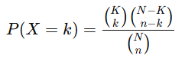
Hyper Geometric
The Hypergeometric Distribution is used when we randomly sample from a finite population without replacement (unlike the Binomial distribution, which assumes independent trials with replacement).
N = Total population size
K = Number of "successes" in the population
n = Sample size drawn from the population
k = Number of "successes" in the sample
PMF:
Example 1: Quality Control in Manufacturing
A factory produces 1000 smartphones, out of which 50 have defects.
A quality control engineer inspects 10 phones at random.
What is the probability that exactly 2 out of the 10 inspected phones are defective?
Example 2: Lottery System
A lottery has 100 tickets, out of which 5 are winning tickets.
If you buy 4 tickets, what is the probability that exactly 1 of them is a winning ticket?

Slide 2
Quality Control in Manufacturing
Scenario: A factory produces 1000 smartphones, out of which 50 have defects.
Outcomes:
Success: A randomly selected phone is defective.
Failure: A randomly selected phone is not defective.
Use Case: Understanding the probability of finding a certain number of defective items in a quality control check.
Hiring Process
Scenario: A company has 30 applicants for a job, out of which 8 are women. The company shortlists 6 candidates.
Outcomes:
Success: A randomly selected candidate is a woman.
Failure: A randomly selected candidate is a man.
Use Case: Understanding gender distribution in shortlisting processes.
Card Drawing
Scenario: A deck of 52 playing cards has 4 Aces. If you randomly draw 5 cards, what is the probability that exactly 2 of them are Aces?
Outcomes:
Success: The drawn card is an Ace.
Failure: The drawn card is not an Ace.
Use Case: Predicting chance of winning if one goes gambling

Slide 3
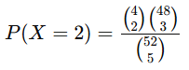
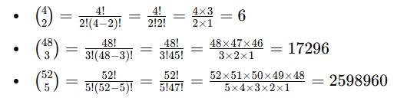
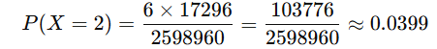
Scenario: A deck of 52 playing cards has 4 Aces. If you randomly draw 5 cards, what is the probability that exactly 2 of them are Aces?
Outcomes:
Success: The drawn card is an Ace.
Failure: The drawn card is not an Ace.
Use Case: Predicting chance of winning if one goes gambling
N = Total population size
K = Number of "successes" in the population
n = Sample size drawn from the population
k = Number of "successes" in the sample
N=52 (total deck size)
K=4(total Aces in deck)
n=5 (sample size)
k=2 (desired number of Aces in sample)
PMF:

Slide 4
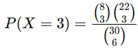
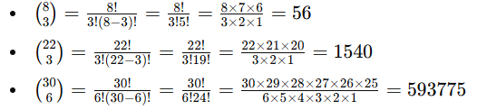
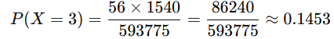
Hiring Process
Scenario: A company has 30 applicants for a job, out of which 8 are women. The company shortlists 6 candidates.
Outcomes:
Success: There are 3 woman in the randomly select set
Failure: A randomly selected candidate is a man.
Use Case: Understanding gender distribution in shortlisting processes.
N = Total population size
K = Number of "successes" in the population
n = Sample size drawn from the population
k = Number of "successes" in the sample
N=30 (total applicants)
K=8 (total women in applicant pool)
n=6 (sample size)
k=3 (desired number of women in shortlist)
PMF:

Slide 5
Employee Selection for a Project
Scenario: A company has 40 employees, of whom 10 are data analysts. A manager selects 8 employees for a special project.
Outcomes:
Success: A selected employee is a data analyst.
Failure: A selected employee is not a data analyst.
Use Case: Understanding the probability of selecting a specific number of data analysts in the team.
Selecting Medical Trial Participants
Scenario: A hospital is conducting a clinical trial with 200 patients, out of which 60 have a specific medical condition. A random group of 20 patients is selected for a new treatment.
Outcomes:
Success: A selected patient has the medical condition.
Failure: A selected patient does not have the medical condition.
Use Case: Determining the likelihood of including a certain number of patients with the condition in the trial.
Voter Sampling in an Election
Scenario: A city has 500,000 registered voters, of whom 200,000 support a particular candidate. A polling agency randomly surveys 1,000 voters.
Outcomes:
Success: A selected voter supports the candidate.
Failure: A selected voter does not support the candidate.
Use Case: Predicting election outcomes based on a sample of surveyed voters.

Slide 6
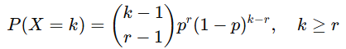
Negative Binomial Distribution
The Negative Binomial Distribution models the number of trials X required to achieve a fixed number of successes r, where each trial has a probability of success p.
It is often considered a generalization of the Geometric Distribution, which is the special case when r=1.
Key Characteristics of Negative Binomial Distribution
Random Variable (X): Number of trials needed to achieve r successes.
Parameters:
r: Number of successes to achieve.
p: Probability of success in each trial.
k = number of trials (must be greater than or equal to r).
Probability Mass Function (PMF):
PMF:

Slide 7
Customer Support Calls
Scenario: A call center tracks how many calls it takes to resolve 3 customer complaints.
Outcomes:
Success: A complaint is resolved.
Failure: A complaint remains unresolved.
Use Case: Understanding how many calls are required to achieve a fixed number of complaint resolutions.
Manufacturing Defects
Scenario: A factory monitors the number of items produced until 5 defect-free items are manufactured.
Outcomes:
Success: A defect-free item is produced.
Failure: A defective item is produced.
Use Case: Estimating the production cost or time required to produce defect-free items.
Sports (Basketball Shooting)
Scenario: A basketball player shoots free throws until they make 4 successful shots.
Outcomes:
Success: A free throw is successful.
Failure: A free throw is missed.
Use Case: Predicting the number of attempts required for a player to achieve a target.

Slide 8
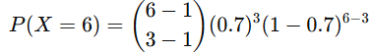
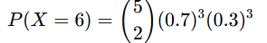
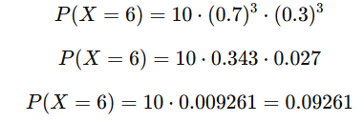
Customer Complaints
Question: A call center resolves 70% of customer complaints on a single call. What is the probability that it takes exactly 6 calls to resolve 3 complaints?
r: Number of successes to achieve.
p: Probability of success in each trial.
k = number of trials (must be greater than or equal to r).
r=3 (target number of successes)
p=0.7 (probability of success)
k=6 (total trials)

Slide 9
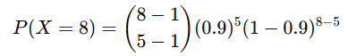
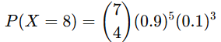
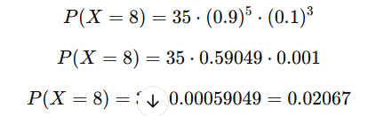
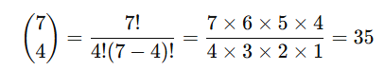
Manufacturing Defects
A factory produces items where 90% are defect-free. What is the probability that it takes 8 items to produce 5 defect-free items?
r: Number of successes to achieve.
p: Probability of success in each trial.
k = number of trials (must be greater than or equal to r).
r=5 (target successes)
p=0.9 (probability of success)
k=8 (total trials)
PMF:

Slide 11
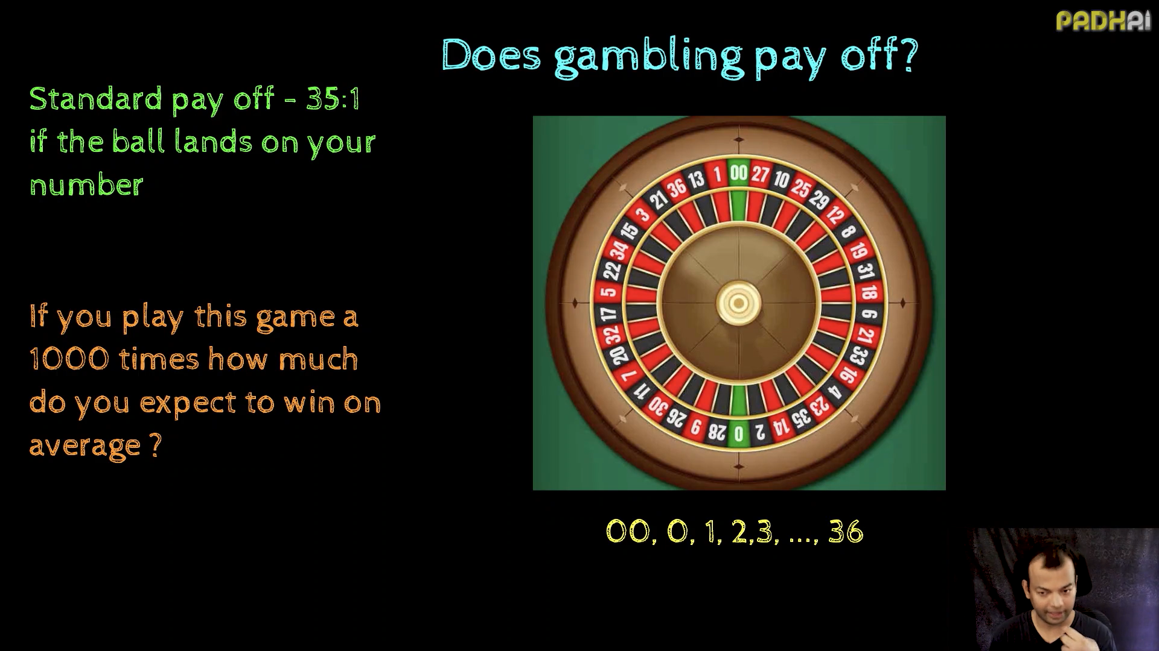

Slide 12
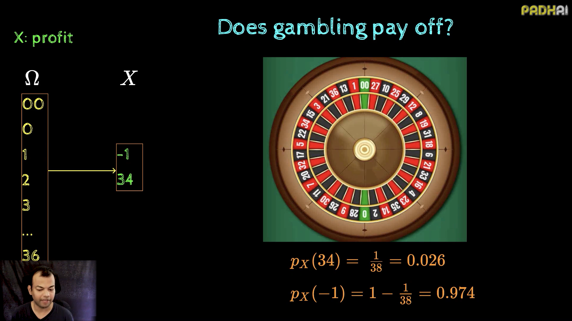

Slide 13
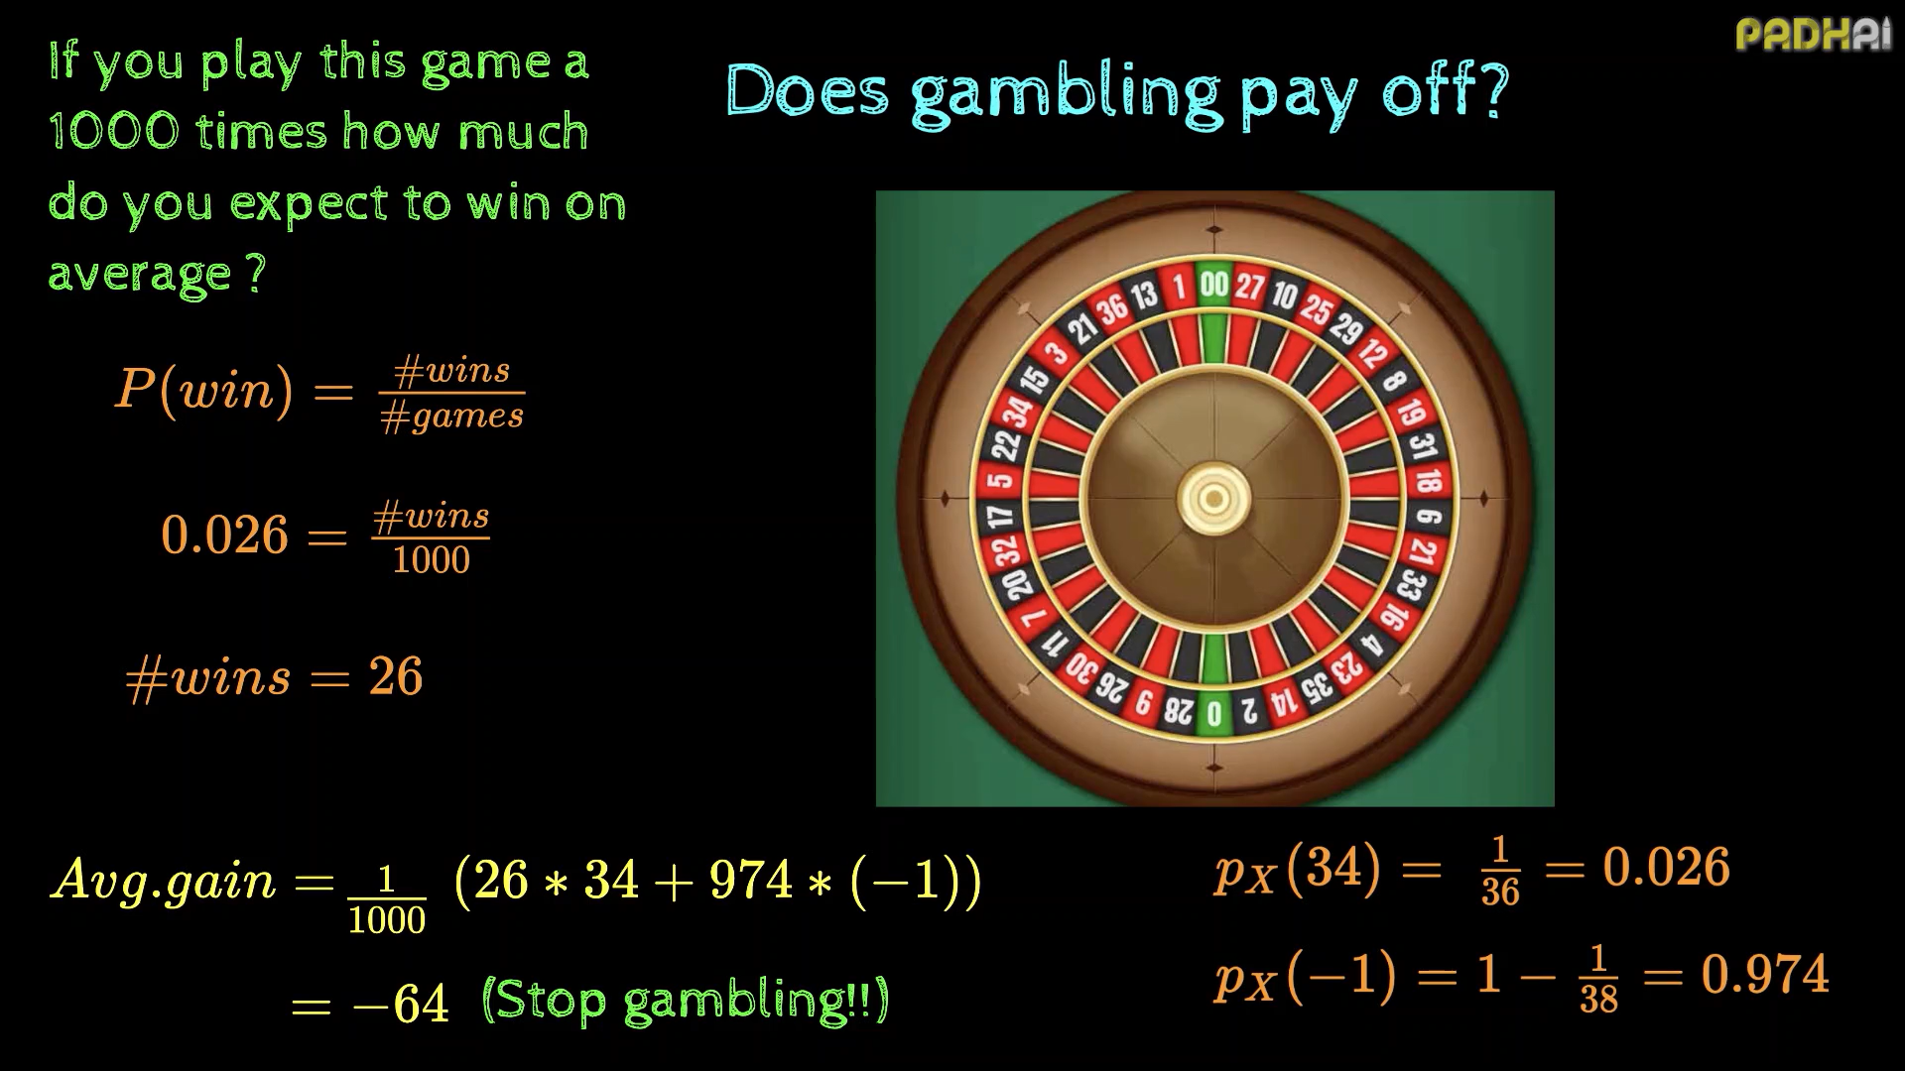

Slide 14
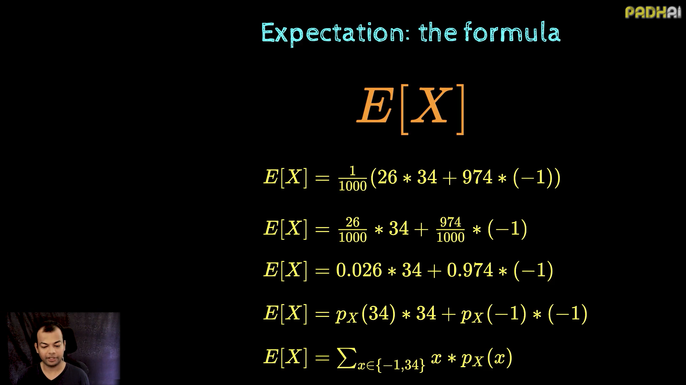

Slide 15
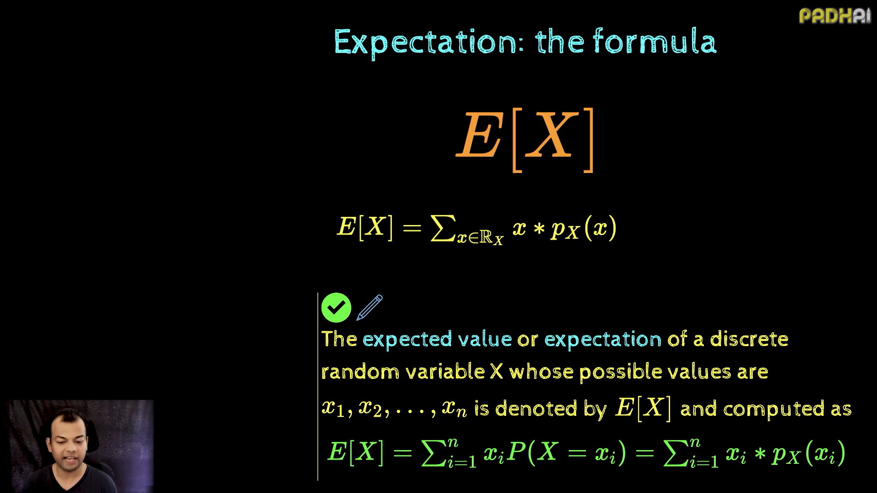

Slide 16
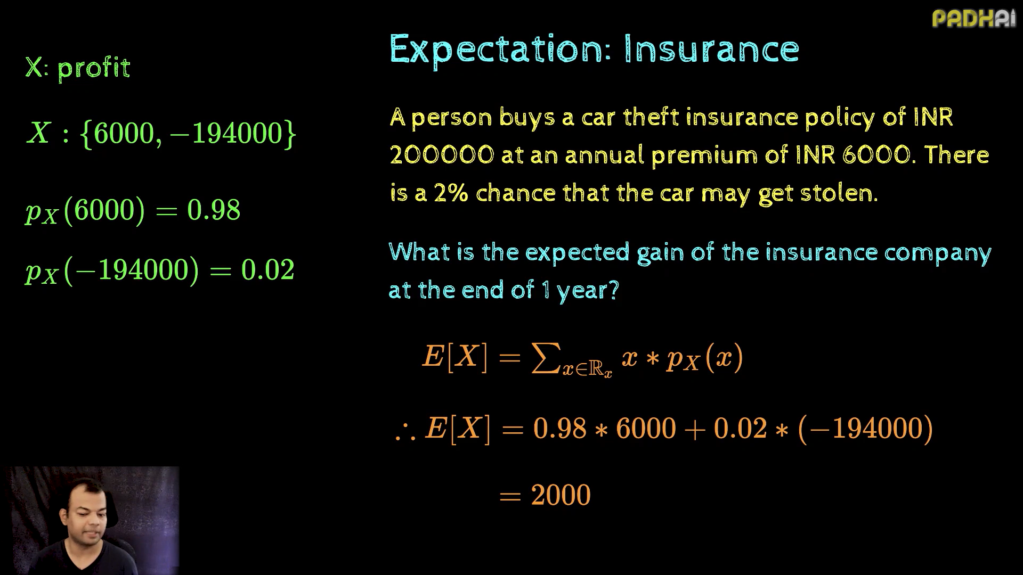

Slide 17
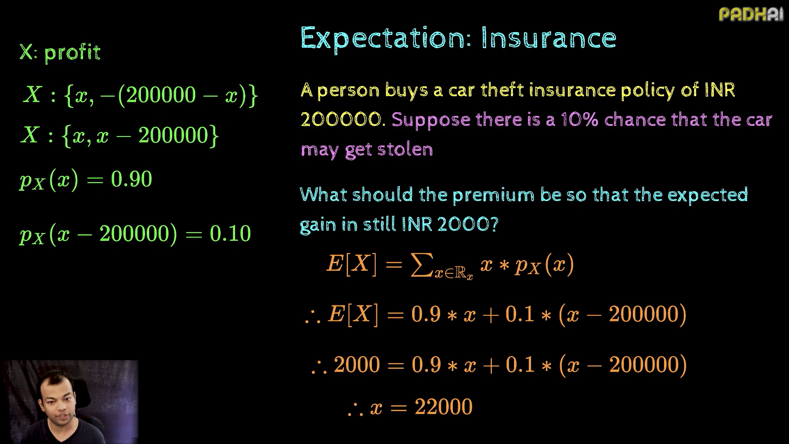

Slide 18
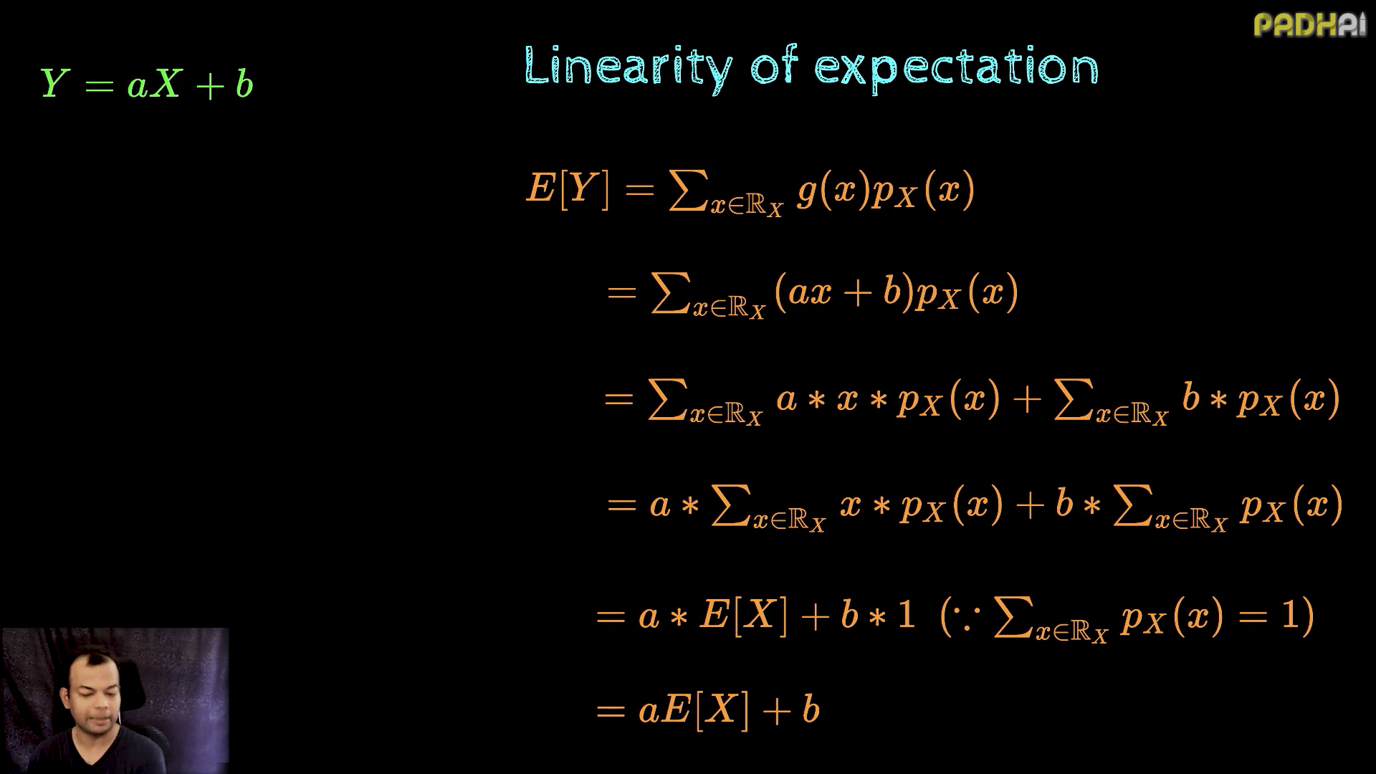

Slide 19
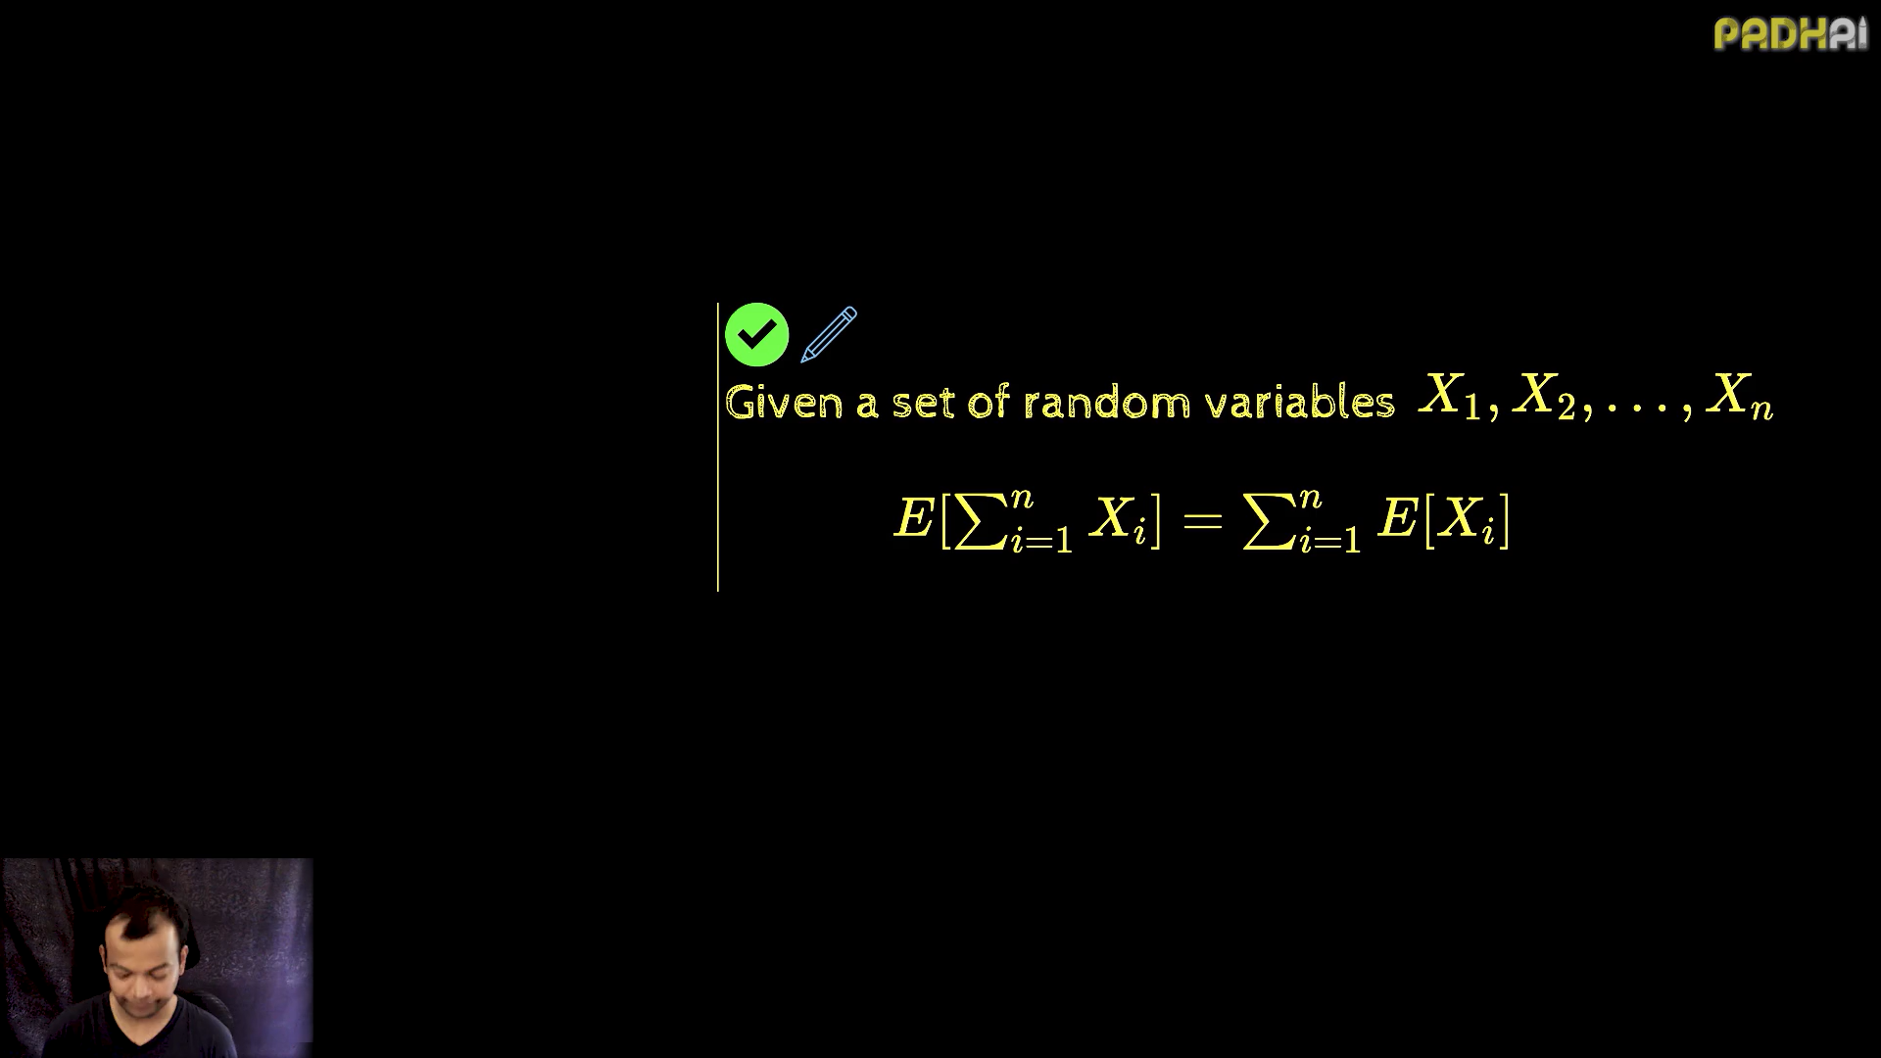

Slide 20
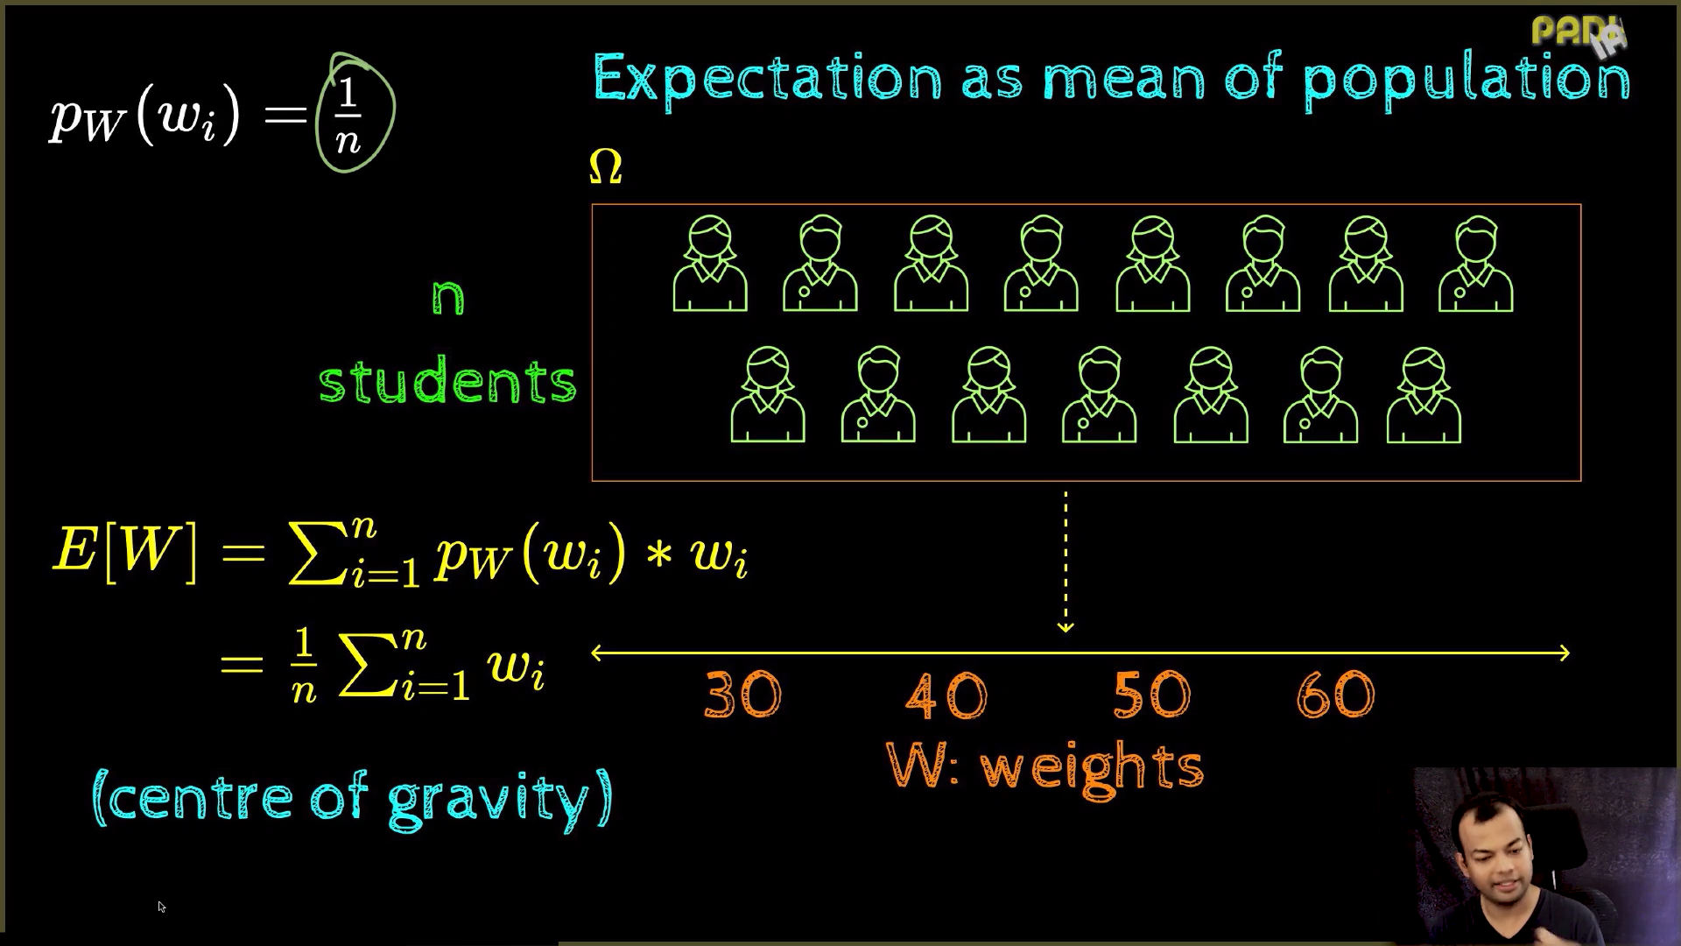

Slide 21
